Slide 1
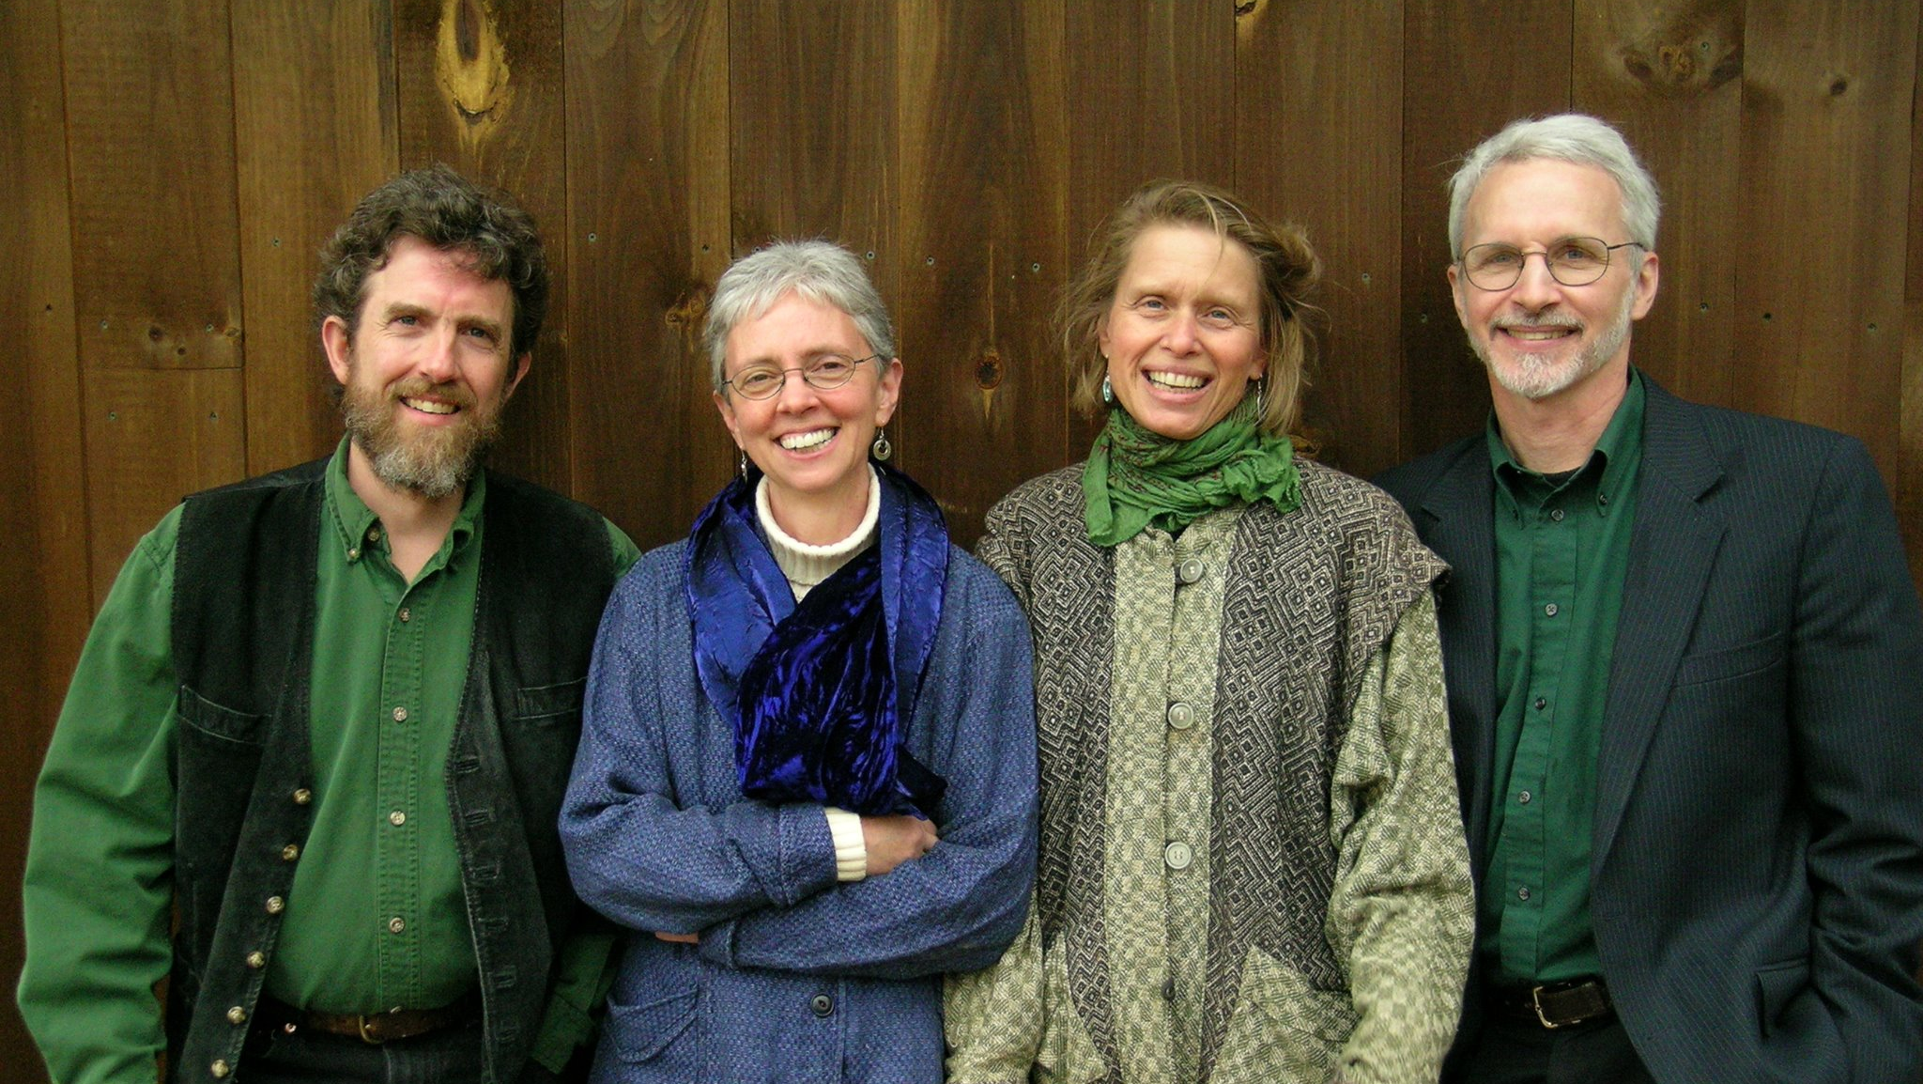

Favorite Singing Games
From The New England Dancing Masters
By Will Doublestein, Bow Tie Music
2024 IMEA Professional Development Conference, Fort Wayne, IN

Slide 2


My name is Will Doublestein and I’m an elementary school general music teacher from Zionsville, IN. I have twelve years of experience and currently teach kindergarten through fourth grade at Boone Meadow Elementary.
I am passionate about making my classroom accessible to anyone, and I use my website (www.bowtiemusic.net) and YouTube channel (www.youtube.com/bowtiemusic) to share lesson ideas with other music teachers around the world. With over 730 videos and approximately 18,500,000 views, Bow Tie Music hosts a library of creative ideas and resources intended to help teachers everywhere become more confident and enthusiastic as they share their love of music with children.
Whether it’s in the classroom, through my videos, or at workshops, I’m always doing my best to push the boundaries of my own creativity by reimagining music class. Through this work I hope to inspire a greater love of teaching in my peers and a great love of learning in my students. I’m so glad you’re joining me on the journey!

Slide 3
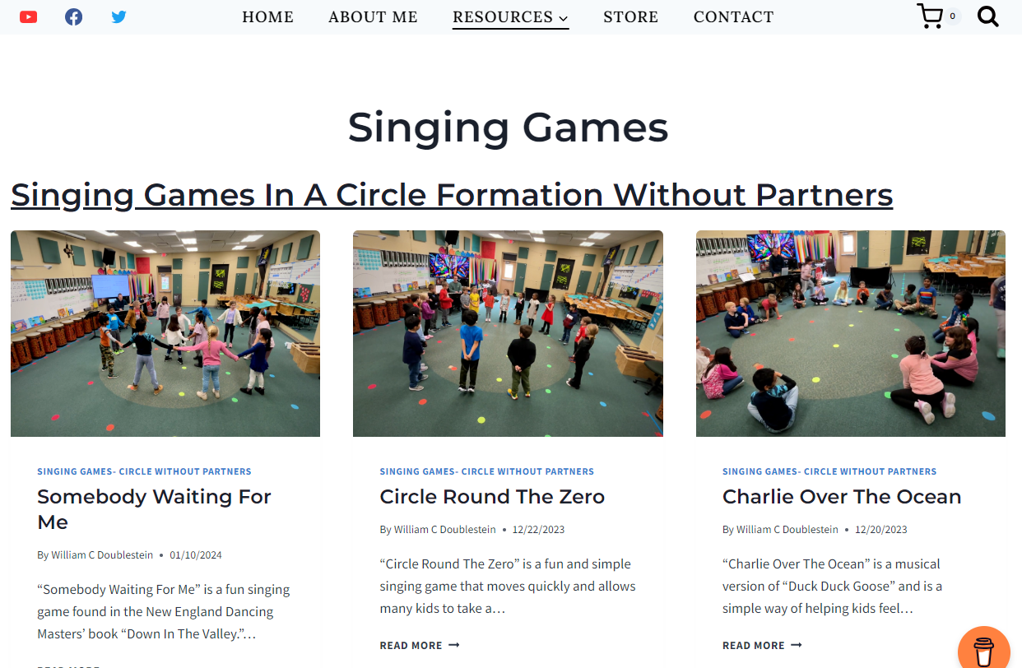
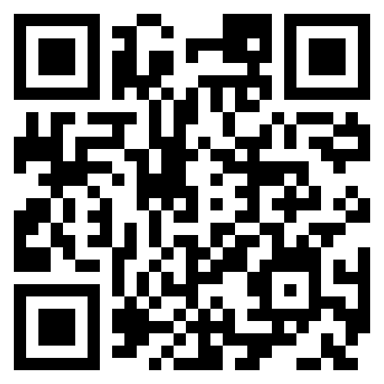
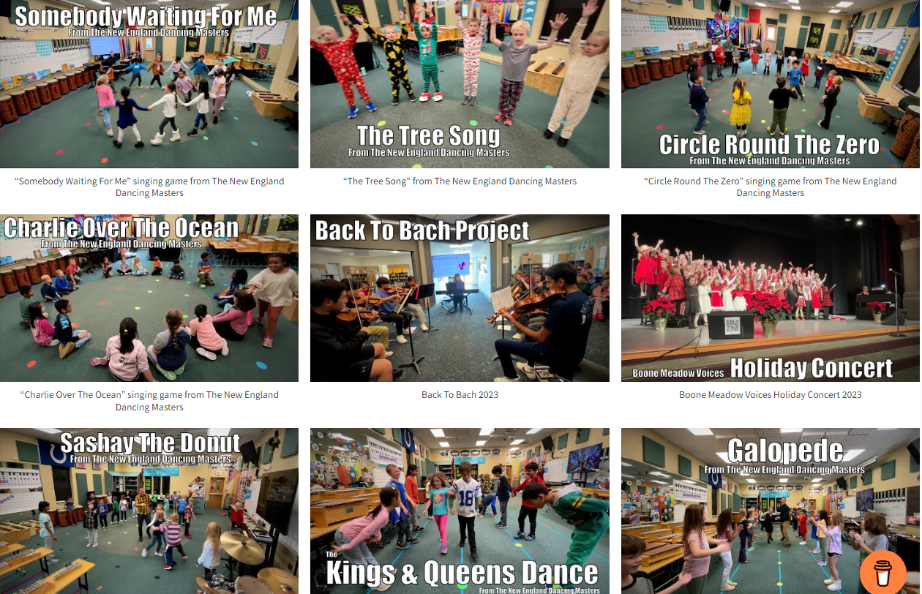
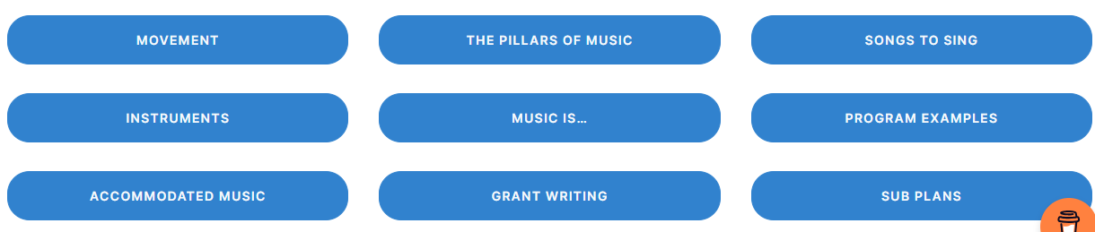
BowTieMusic.net
Bow Tie Music is a lesson sharing platform built to inspire elementary school music teachers through an authentic, practical, and creative approach to music education. Everything you see here is intended to emphasize the belief that kids are awesome, music should be fun, and building a life-long appreciation of music within our students is the pinnacle of this great profession.

Slide 4
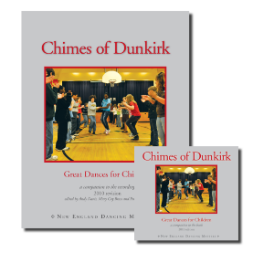
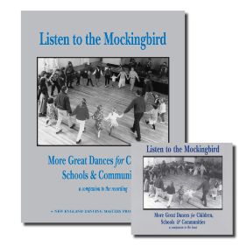
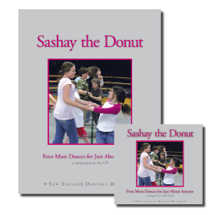
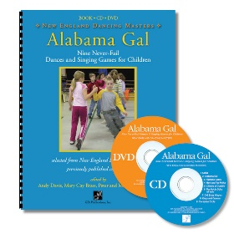
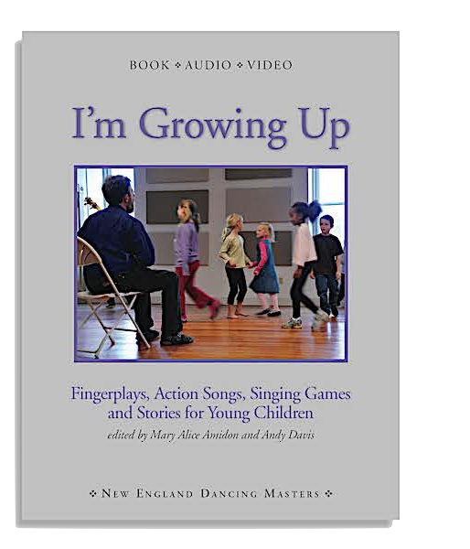
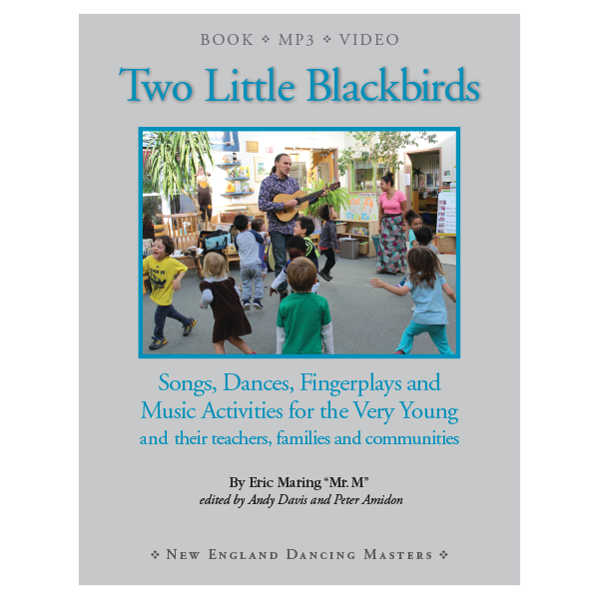
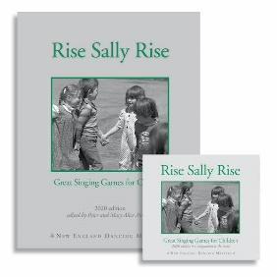
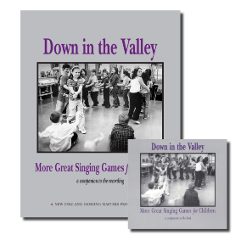
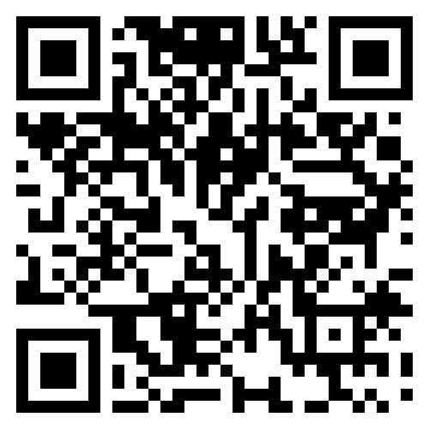
DancingMasters.com
The New England Dancing Masters produce books and recordings of traditional social dances and singing games from North America and the British Isles. Their materials — which are specifically geared to dancers of diverse ages and abilities — are being used by countless teachers, recreation leaders and dance callers. NEDM recordings are made with some of the region’s finest traditional musicians and recreate the excitement of dancing to the live music of a New England contra dance.
Use code “bowtieworkshop10”
for 10% off your entire order
at www.dancingmasters.com

Slide 5
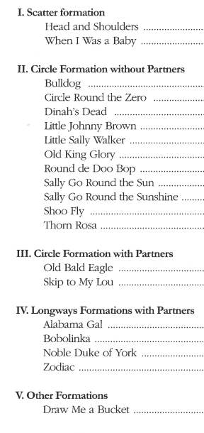
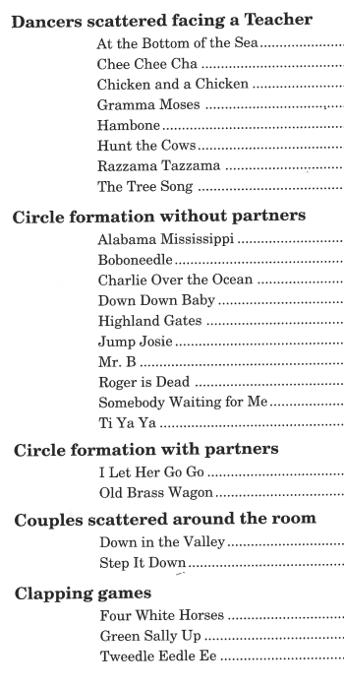
Today’s examples

Slide 6
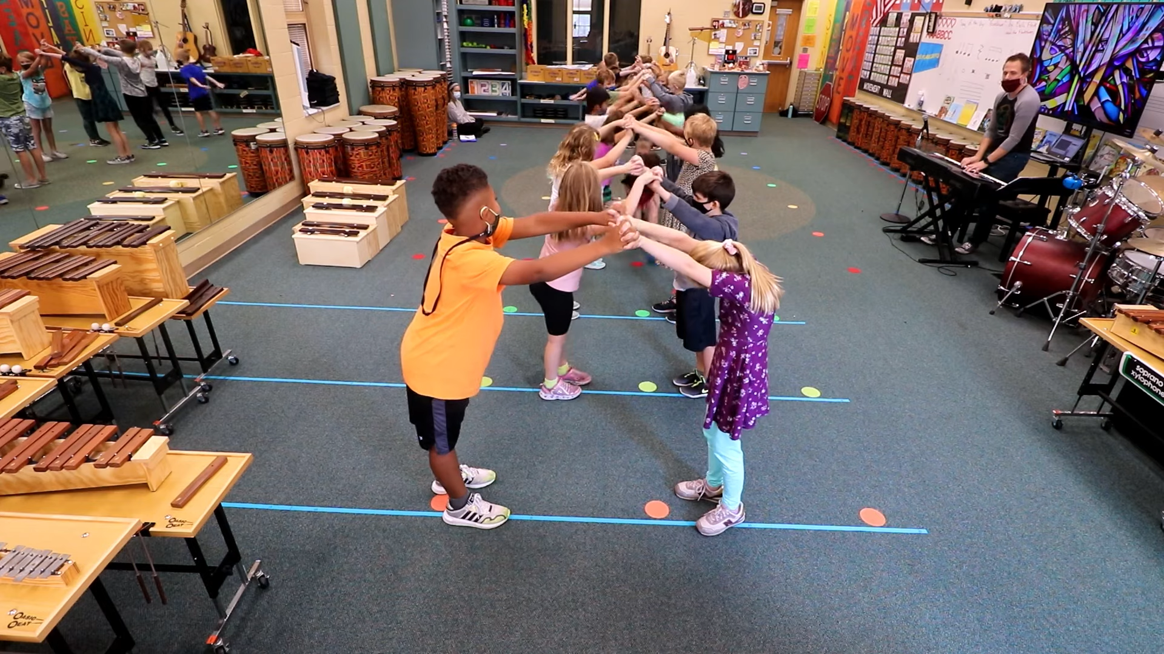
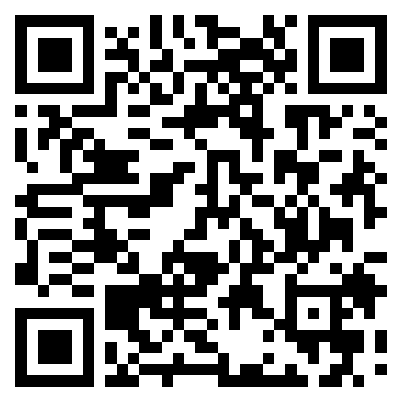
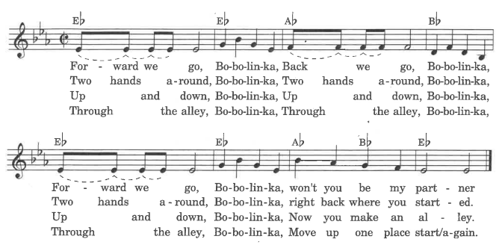
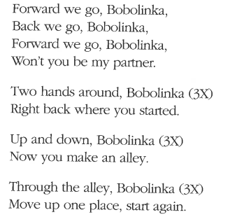
Bobolinka
Singing game in a longways set for any number of partners
https://www.bowtiemusic.net/bobolinka
Pg. 12
Forward (4 beats)
Back (4 beats)
Forward (4 beats)
Back (4 beats)
Two hand turn
Jump up (3xs)
Form alley
Top set travels under alley
Everybody step up

Slide 7
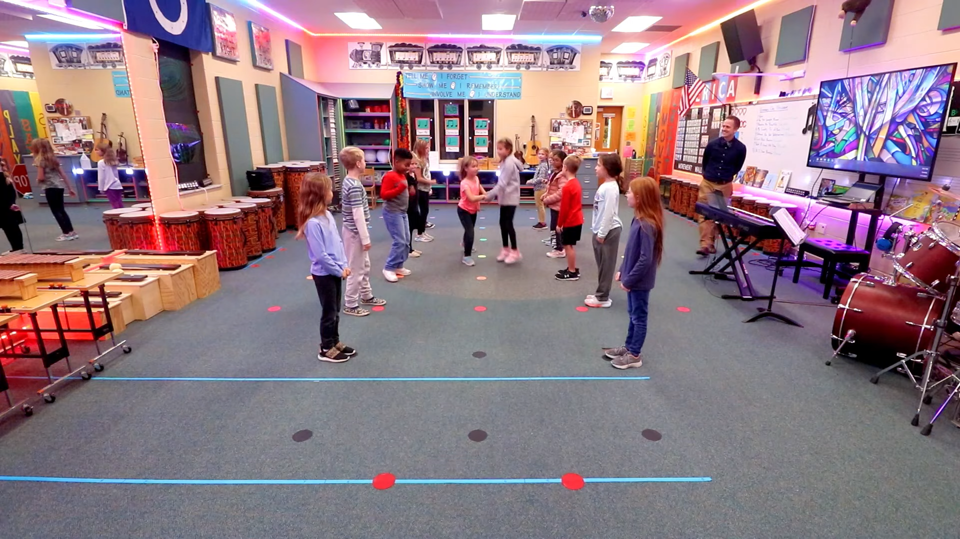
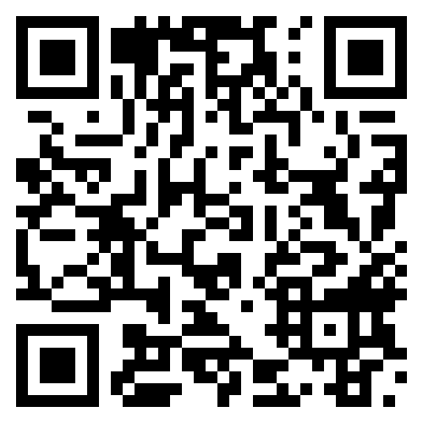
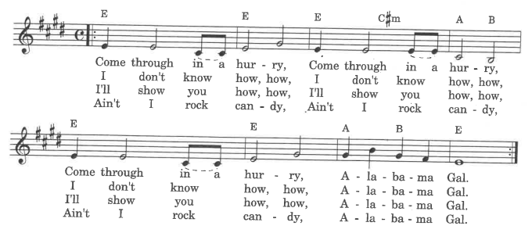

Alabama Gal
Singing game in a longways set for 6-8 partner sets
https://www.bowtiemusic.net/alabama-gal
Pg. 10
Sashay down (8 beats)
Sashay back (8 beats)
Right arm turn (8 beats)
Left arm turn (8 beats)
Cast off and make a bridge
(16 beats)
Head on through
(16 beats)

Slide 8
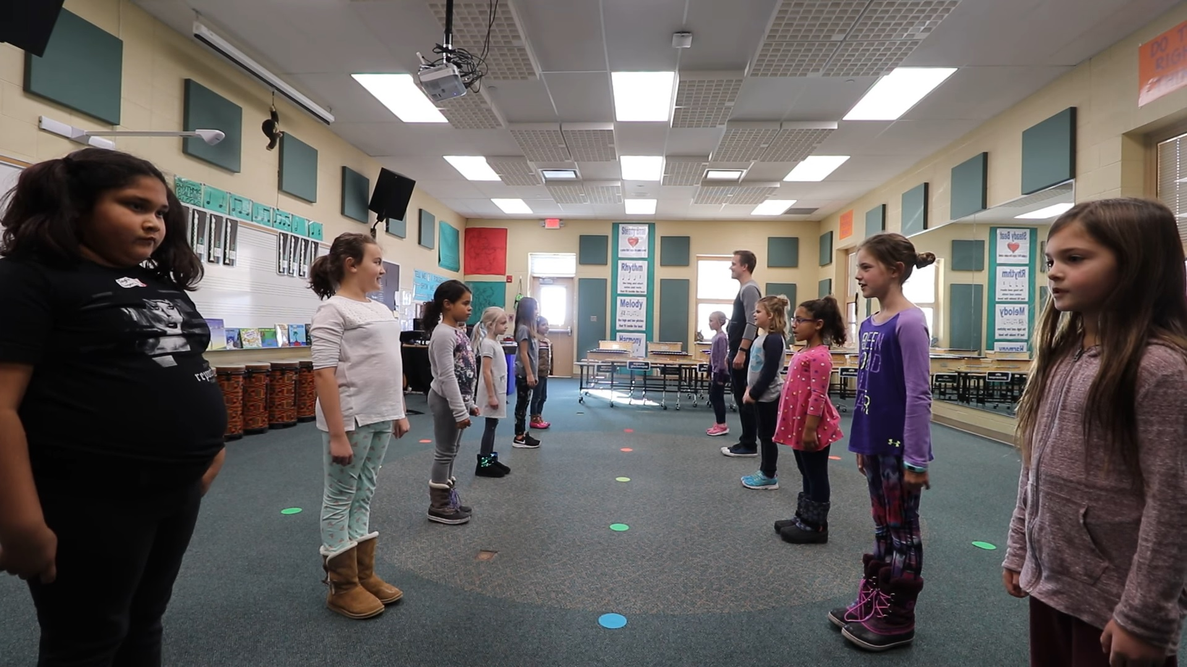
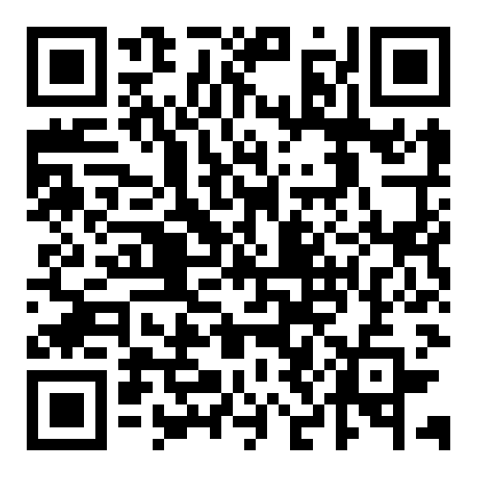
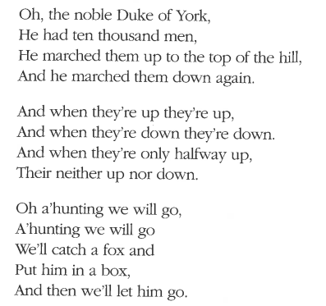
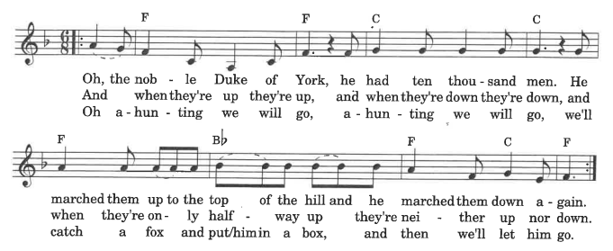
The Noble Duke of York
Singing game in a longways set for 6-8 partner sets
https://bowtiemusic.net/the-noble-duke-of-york/
Pg. 24
Forward-- high five (4 beats)
Back (4 beats)
Dosido (8 beats
Sashay down (8 beats)
Sashay back (8 beats)
Cast off and make a bridge
(16 beats)
Head on through (16 beats)

Slide 9
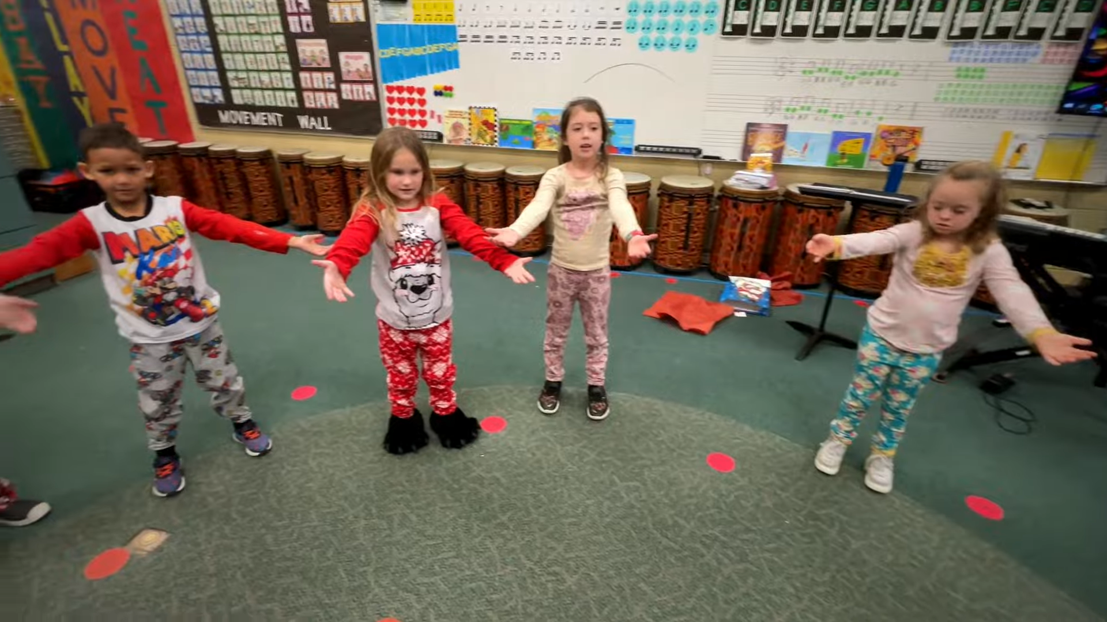
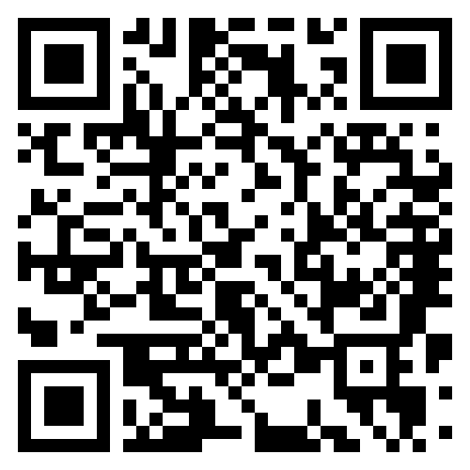
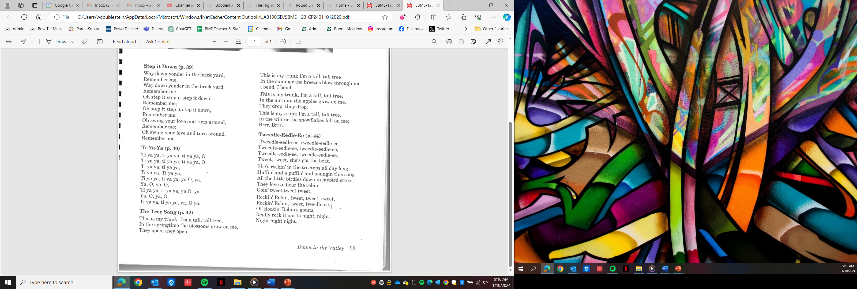
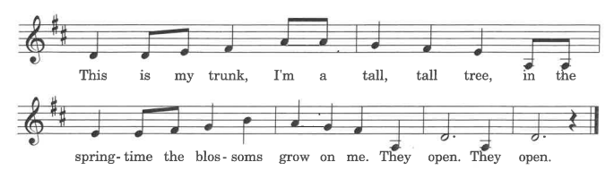
The Tree Song
Song with motions
https://bowtiemusic.net/the-tree-song/
Pg. 42

Slide 10
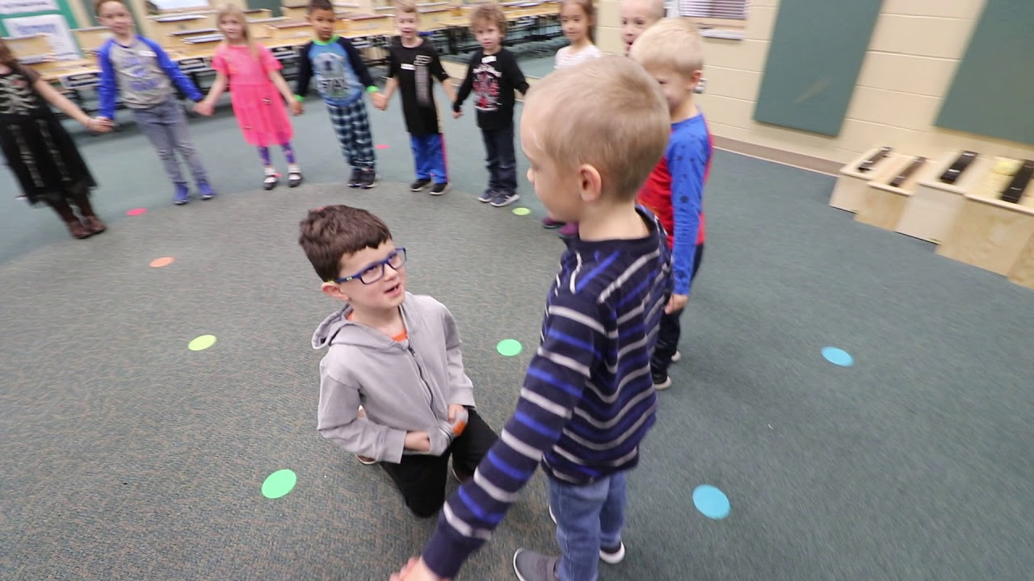
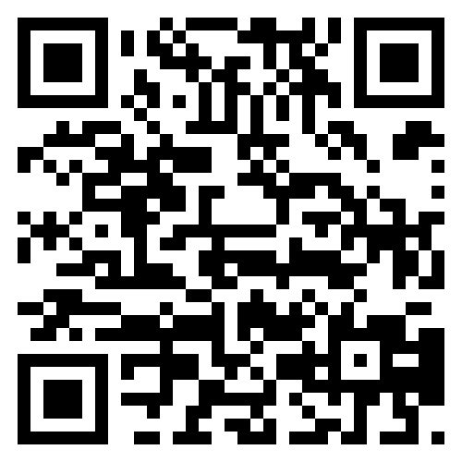

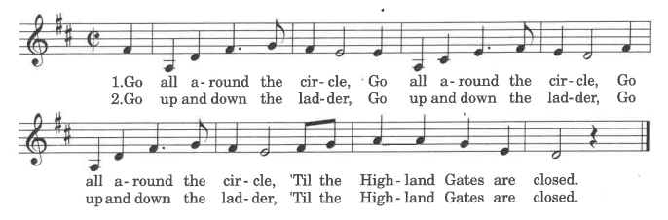
Highland Gates
Singing game in a circle formation
https://bowtiemusic.net/the-highland-gates/
Pg. 24
Circle left
Forward and back
Forward and back
Leader weaves through windows
Leader kneels
Two hand turn

Slide 11
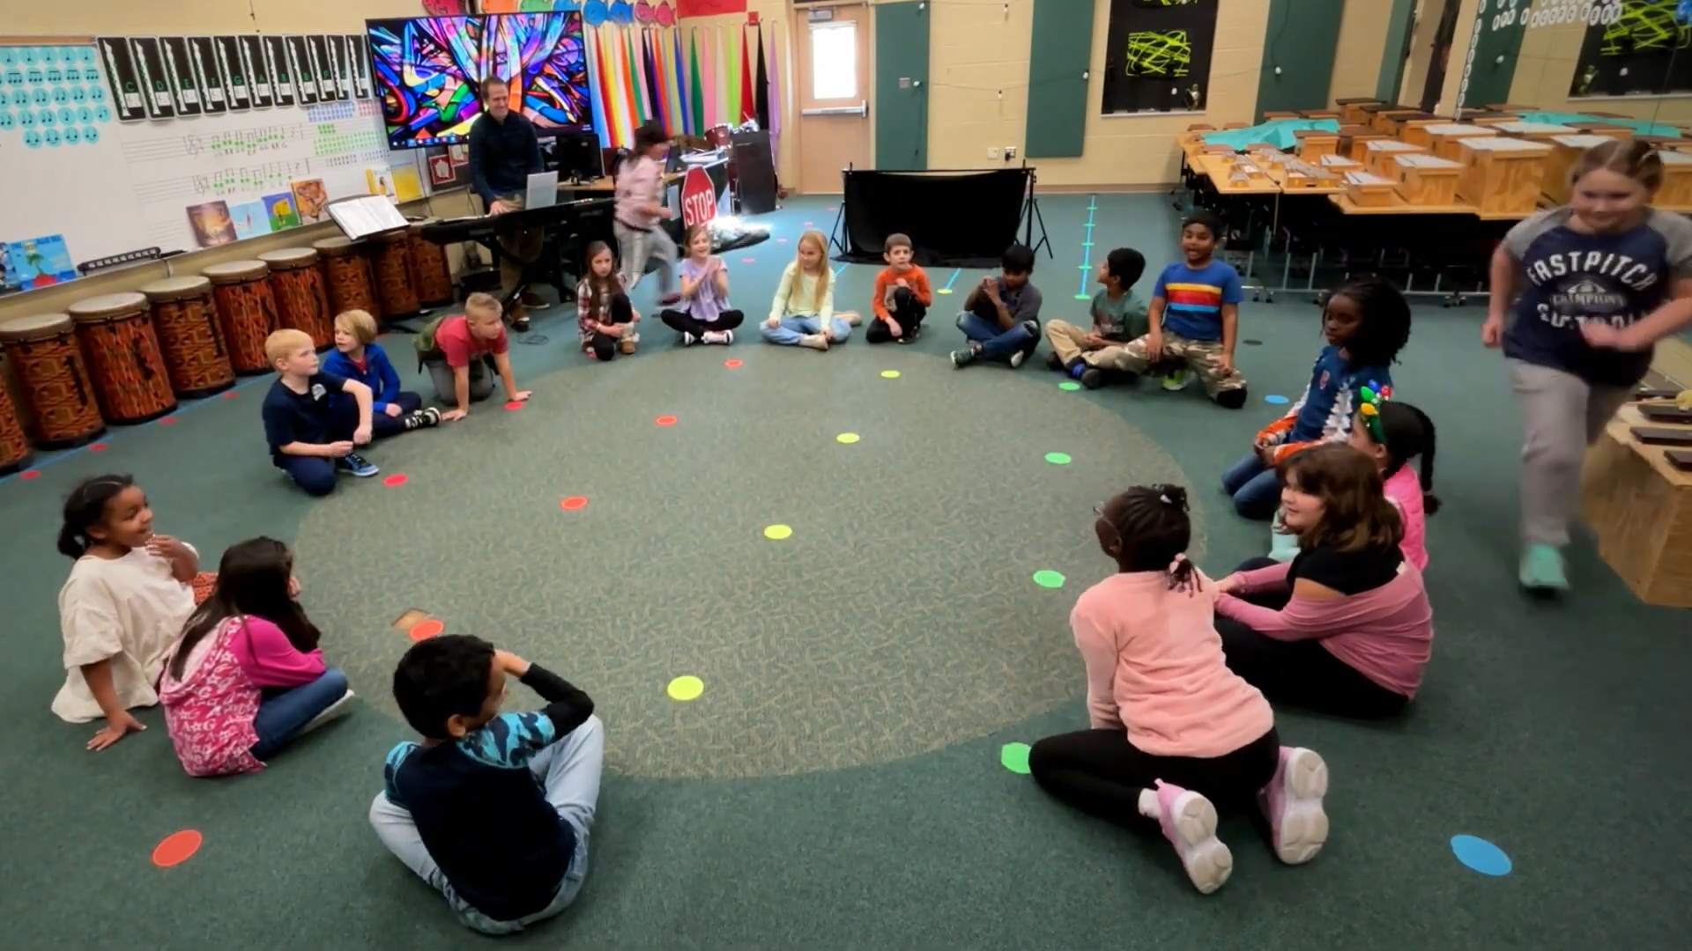
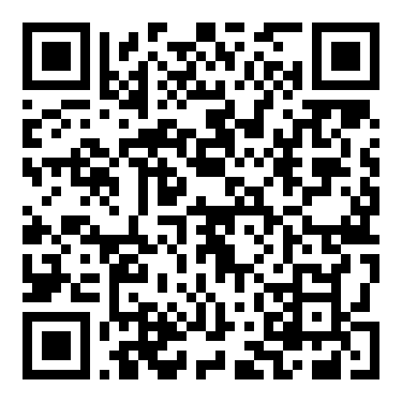
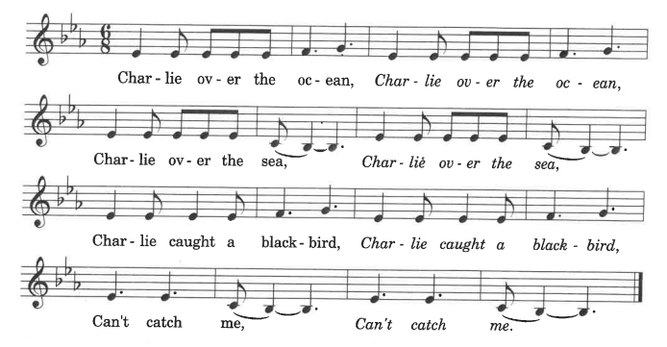

Charlie Over The Ocean
Singing game in a circle formation
https://bowtiemusic.net/charlie-over-the-ocean/
Pg. 11

Slide 12
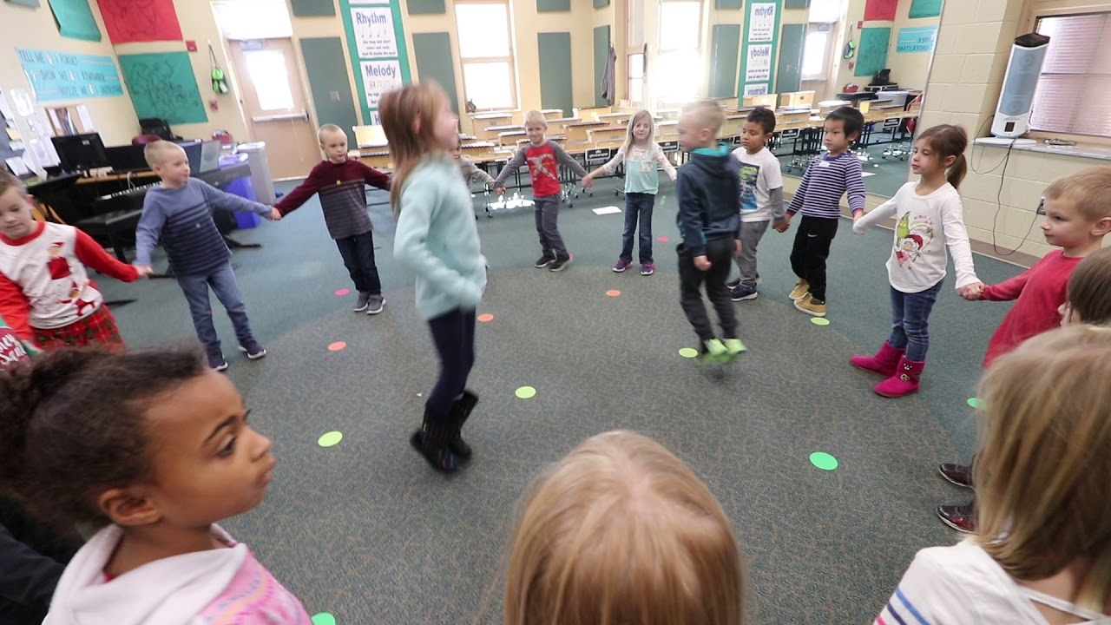
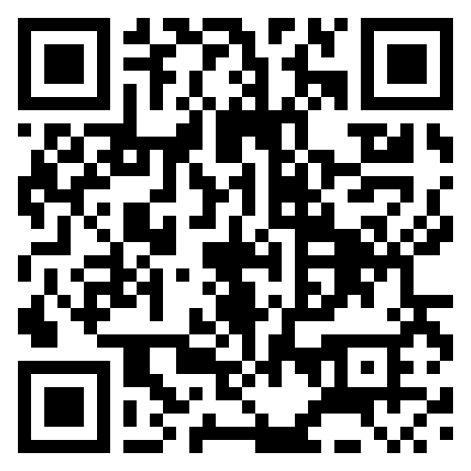
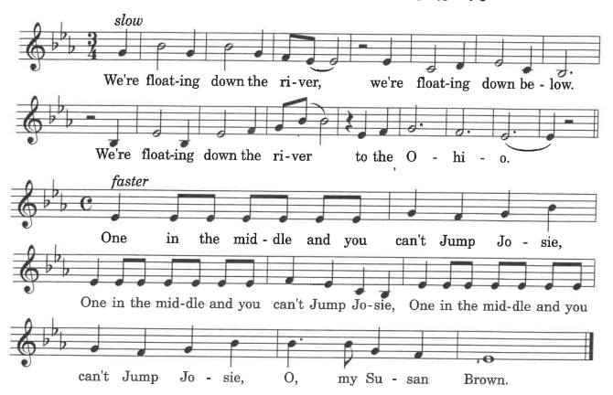
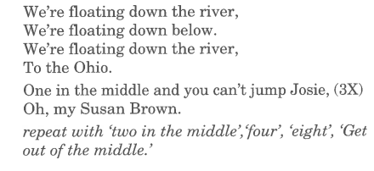
Jump Josie
Singing game in a circle formation
https://bowtiemusic.net/jump-josie/
Pg. 29

Slide 13
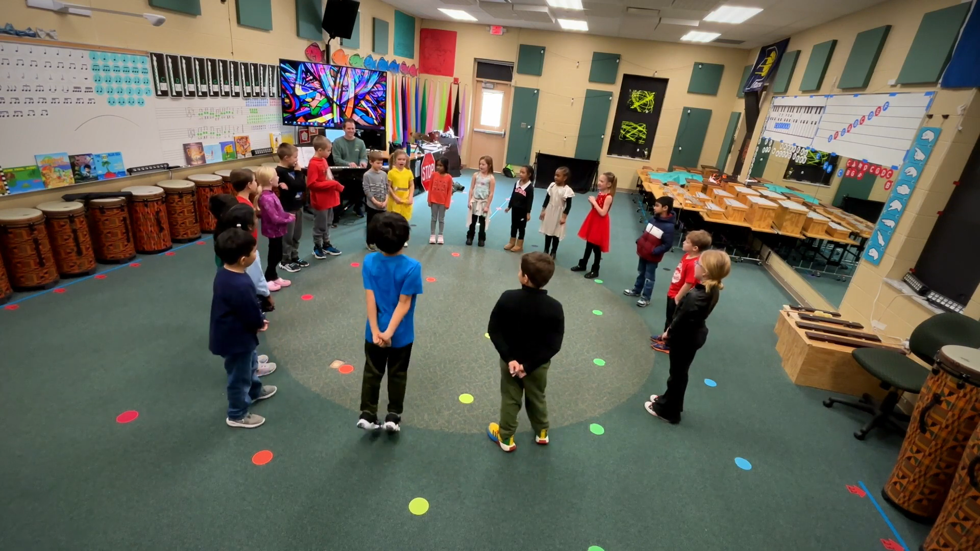
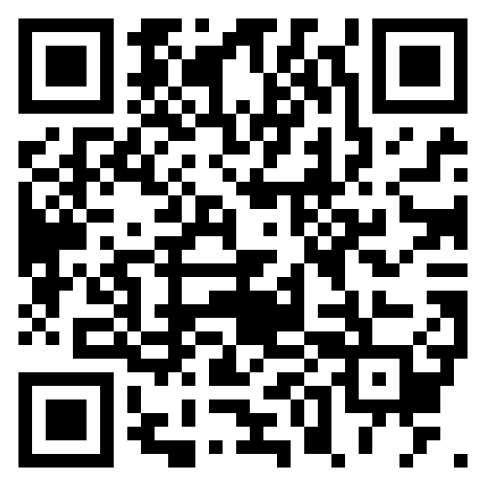
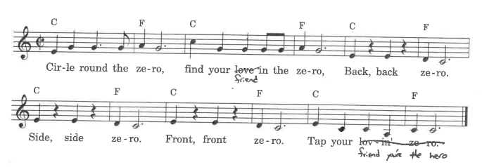
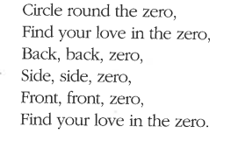
Circle Round The Zero
Singing game in a circle formation
https://bowtiemusic.net/circle-round-the-zero/
Pg. 15
friend
friend you’re the hero.

Slide 14
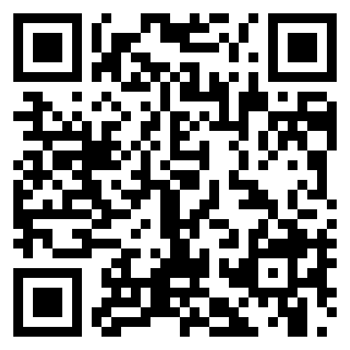
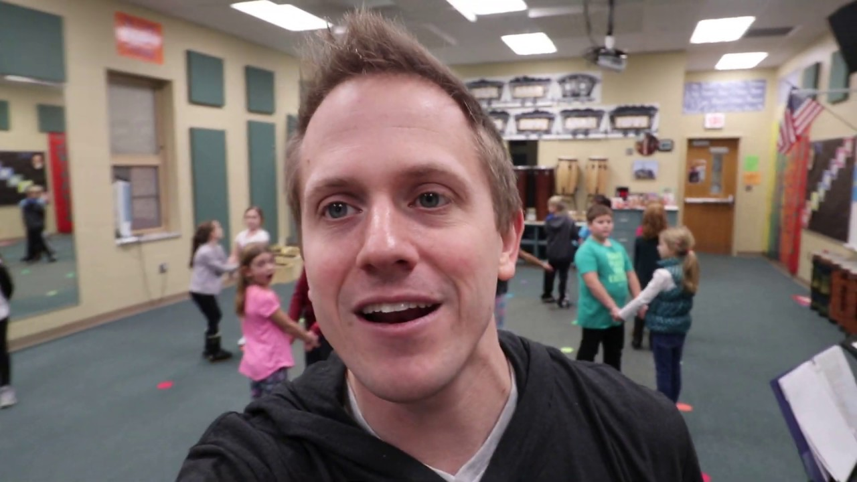
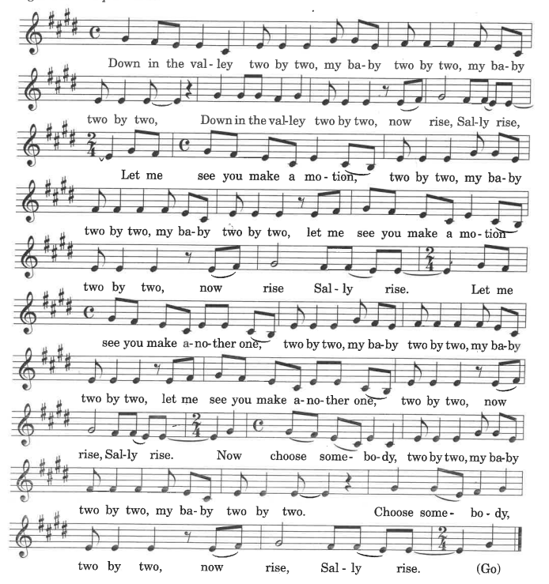
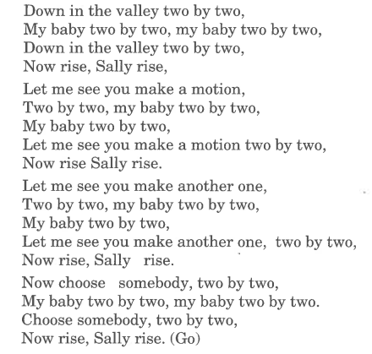
Down In The Valley
Singing game in a circle of partners formation
Pg. 18
https://bowtiemusic.net/down-in-the-valley

Slide 15
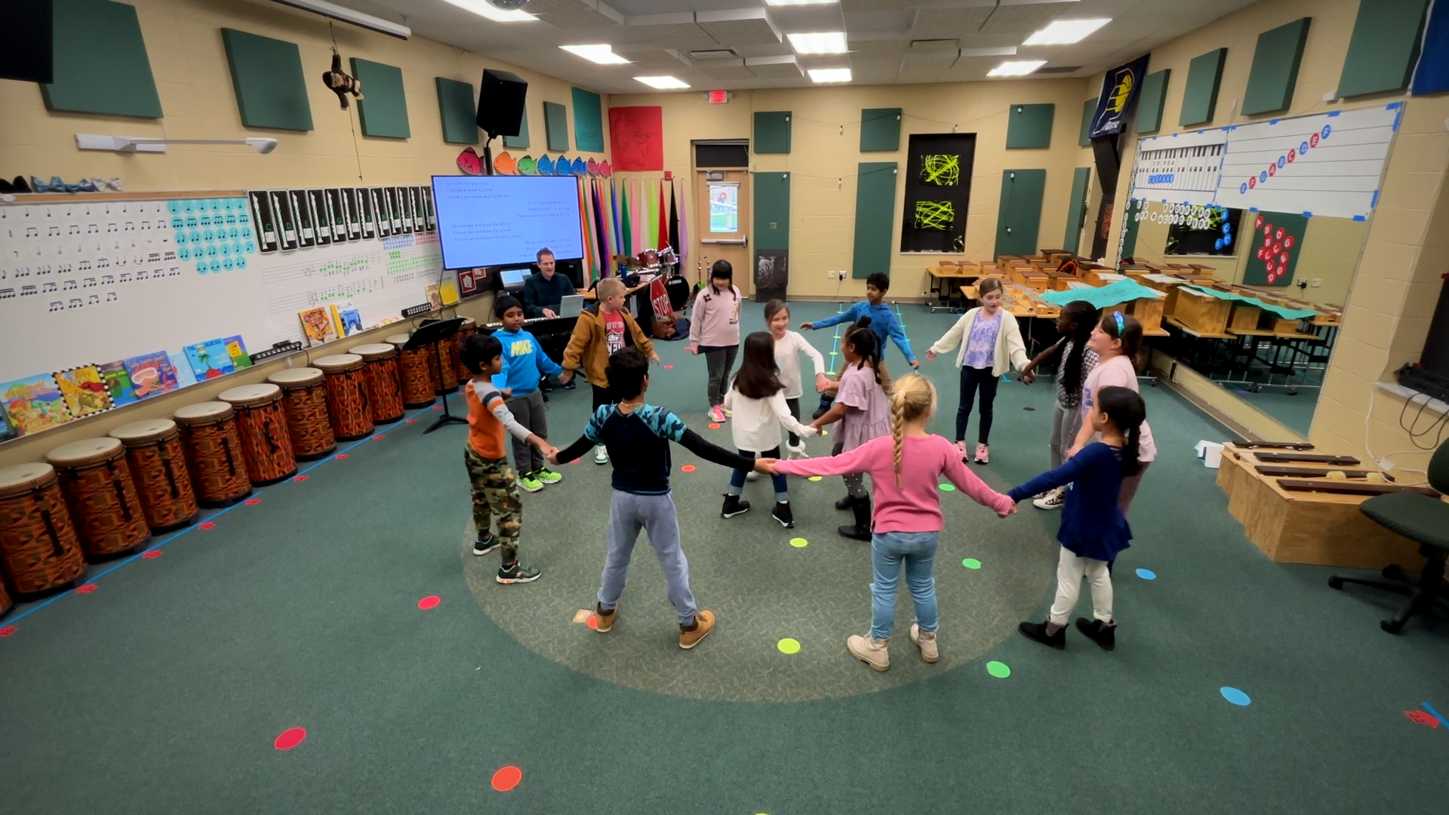



Somebody Waiting For Me
Singing game in a circle formation
https://bowtiemusic.net/somebody-waiting-for-me/
Pg. 38

Slide 16




Skip To My Lou
Singing game in a circle of partners formation
https://bowtiemusic.net/skip-to-my-lou/
Pg. 31

Slide 17




Old King Glory
Singing game in a circle formation
https://bowtiemusic.net/old-king-glory/
Pg. 26

Slide 18




Round De Doo Bop
Singing game in a circle formation
https://bowtiemusic.net/round-de-doo-bop/
Pg. 29

Slide 19




Old Brass Wagon
Singing game in a circle of partners formation
https://bowtiemusic.net/old-brass-wagon/
Pg. 32

Slide 20





Head And Shoulders
Pg. 20
Song with motions
https://bowtiemusic.net/head-and-shoulders

Slide 21

Download This PowerPoint
Purchase These Books At A 10% Discount
With code “bowtieworkshop10”
Contact me at BowTieMusic.net/contact

