Slide 1


Slide 2
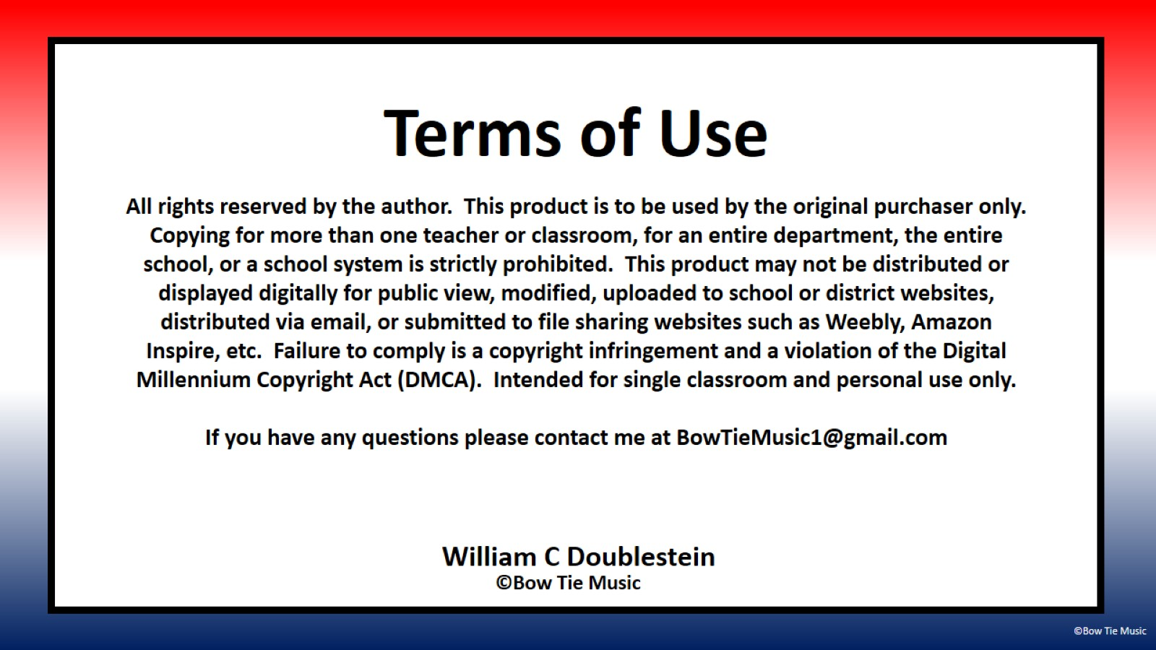

Slide 3

This song was written as a funny way to introduce Veterans Day to kindergartners, and after performing it at our Veterans Day program it has become a classroom and audience favorite. I hope it helps the kindergartners in your life find a little more clarity about the distinction between these two wonderful groups of people.
For an example video of our performance, follow this link:
https://youtu.be/LS-4tzKZi64
To print the sheet music, follow this link: https://drive.google.com/file/d/1USuOjx_eJp9YSZfRFMYUjwIFrVVcNPG5/view?usp=sharing
To download an MP3 of the accompaniment, follow this link: https://drive.google.com/file/d/1dUwuNxNG5UDVv72mHHf84yPRL1jL_e0v/view?usp=sharing
For more resources, including my Veterans Day favorite “Fired Up!,” follow this link: www.TeachersPayTeachers.com/store/Bow-Tie-Music

Slide 4
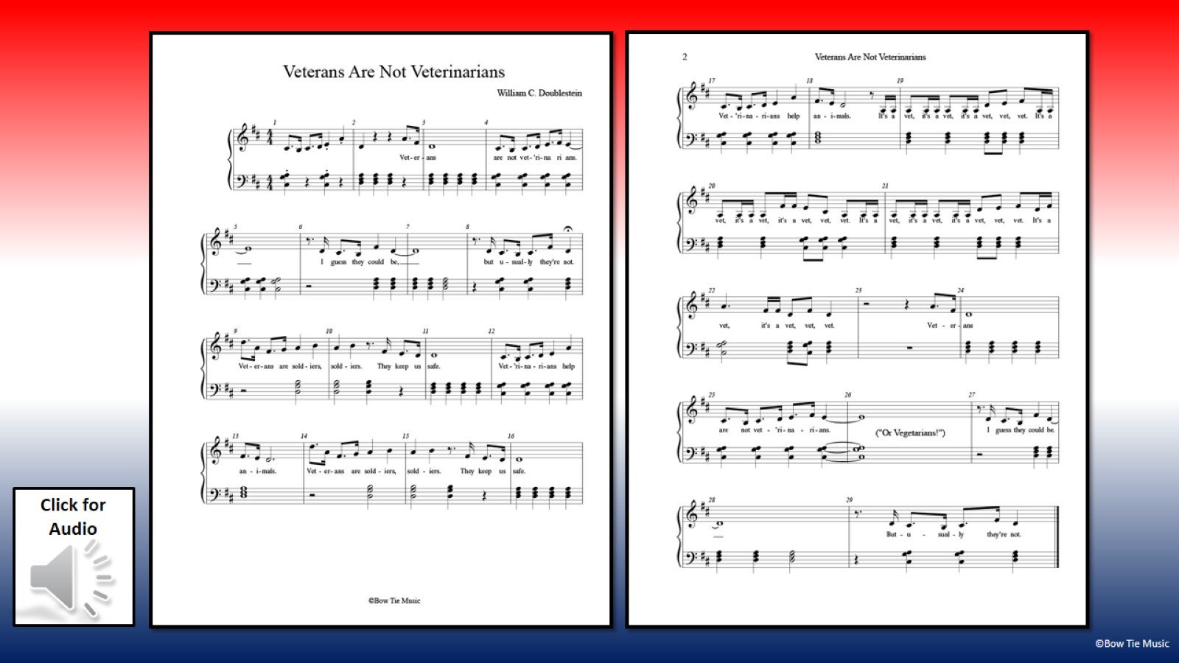


Slide 5
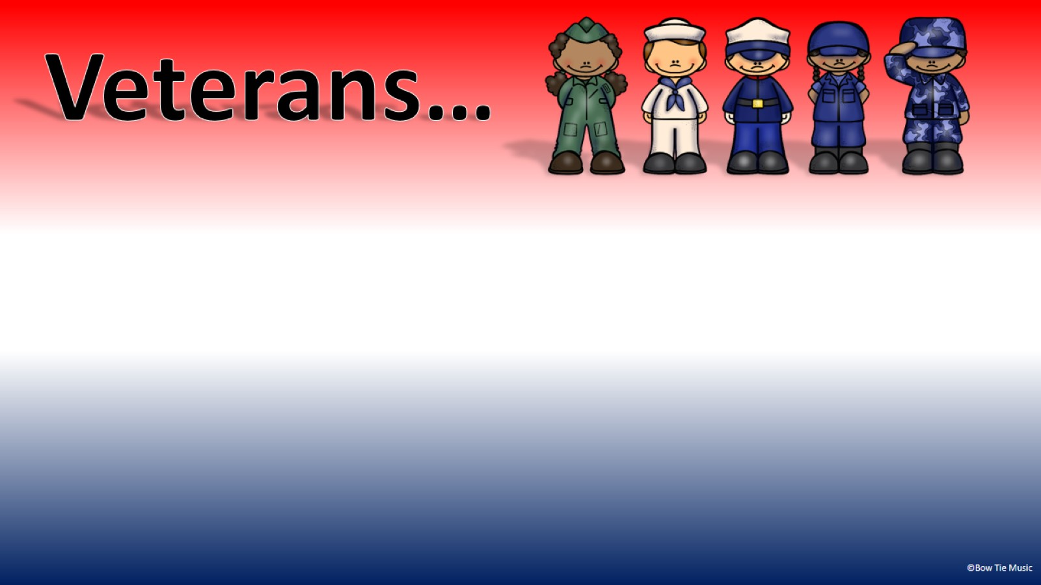

Slide 7


Slide 8


Slide 9
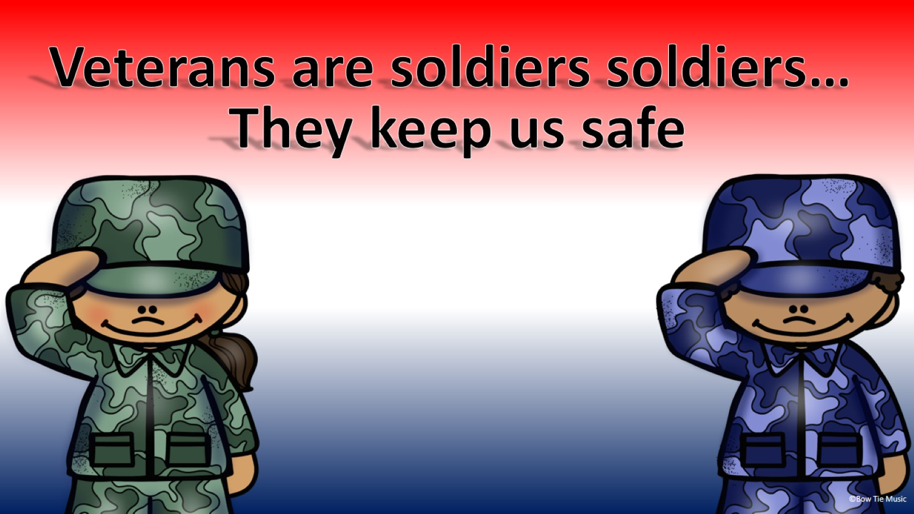

Slide 10


Slide 13
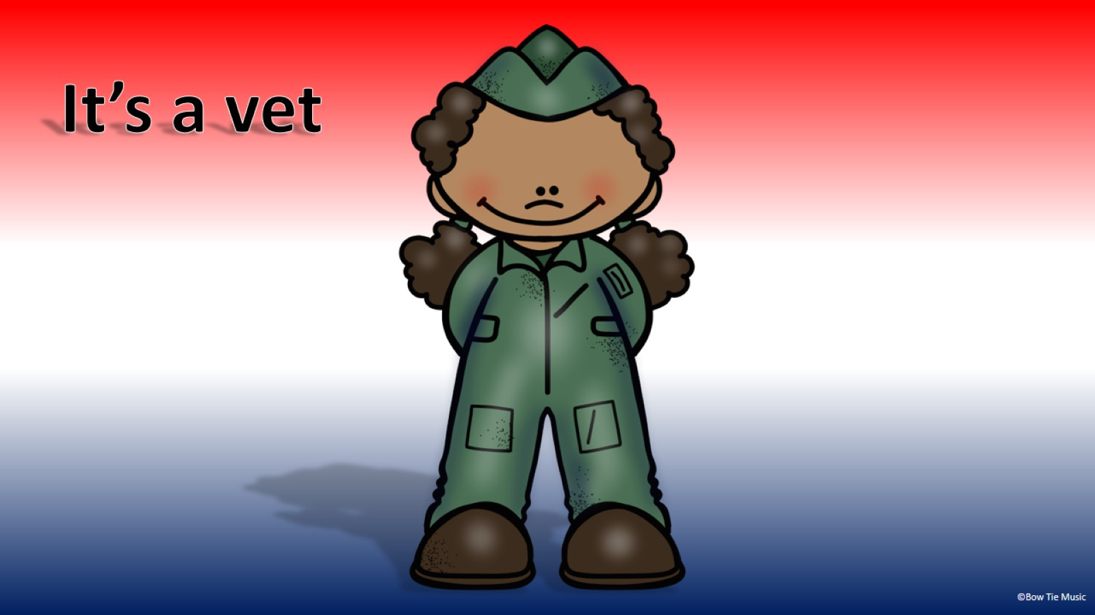

Slide 14
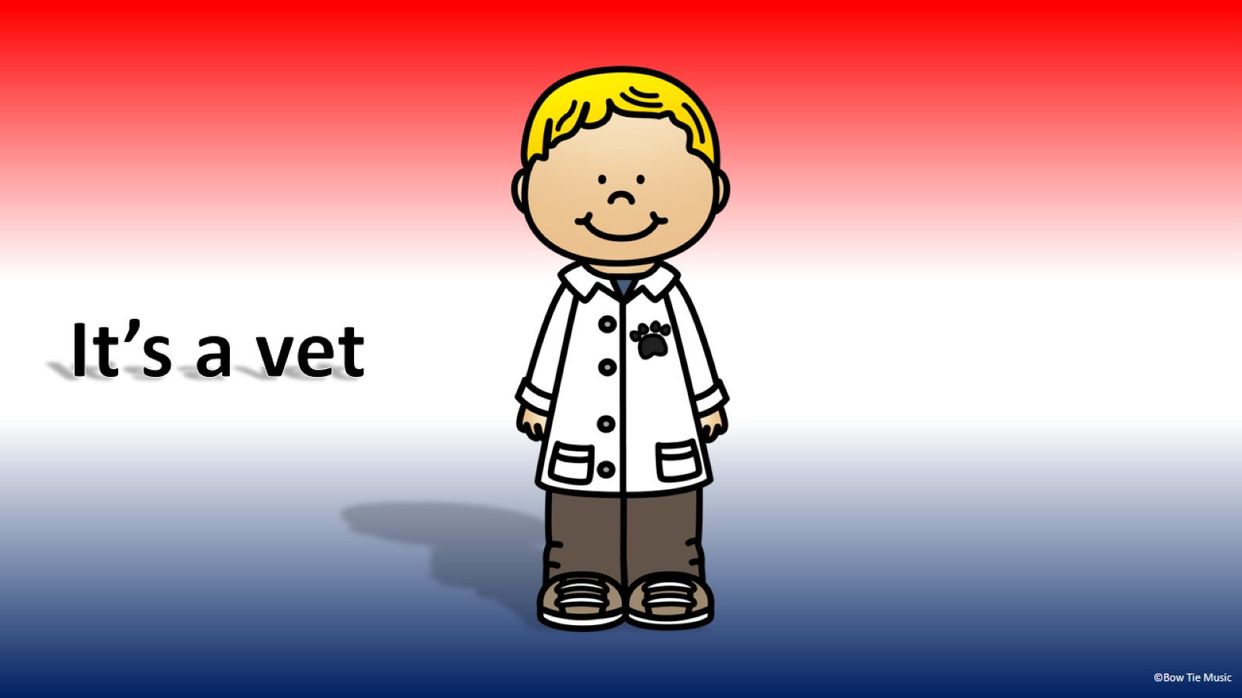

Slide 15
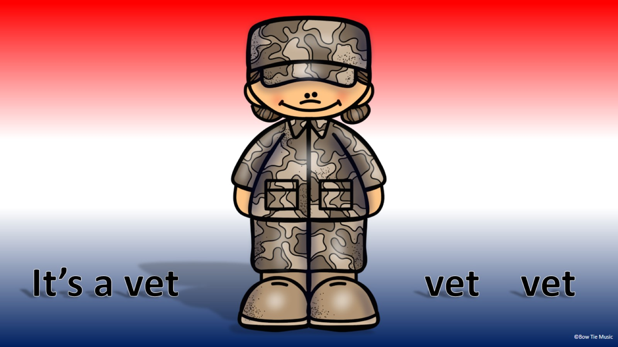

Slide 16
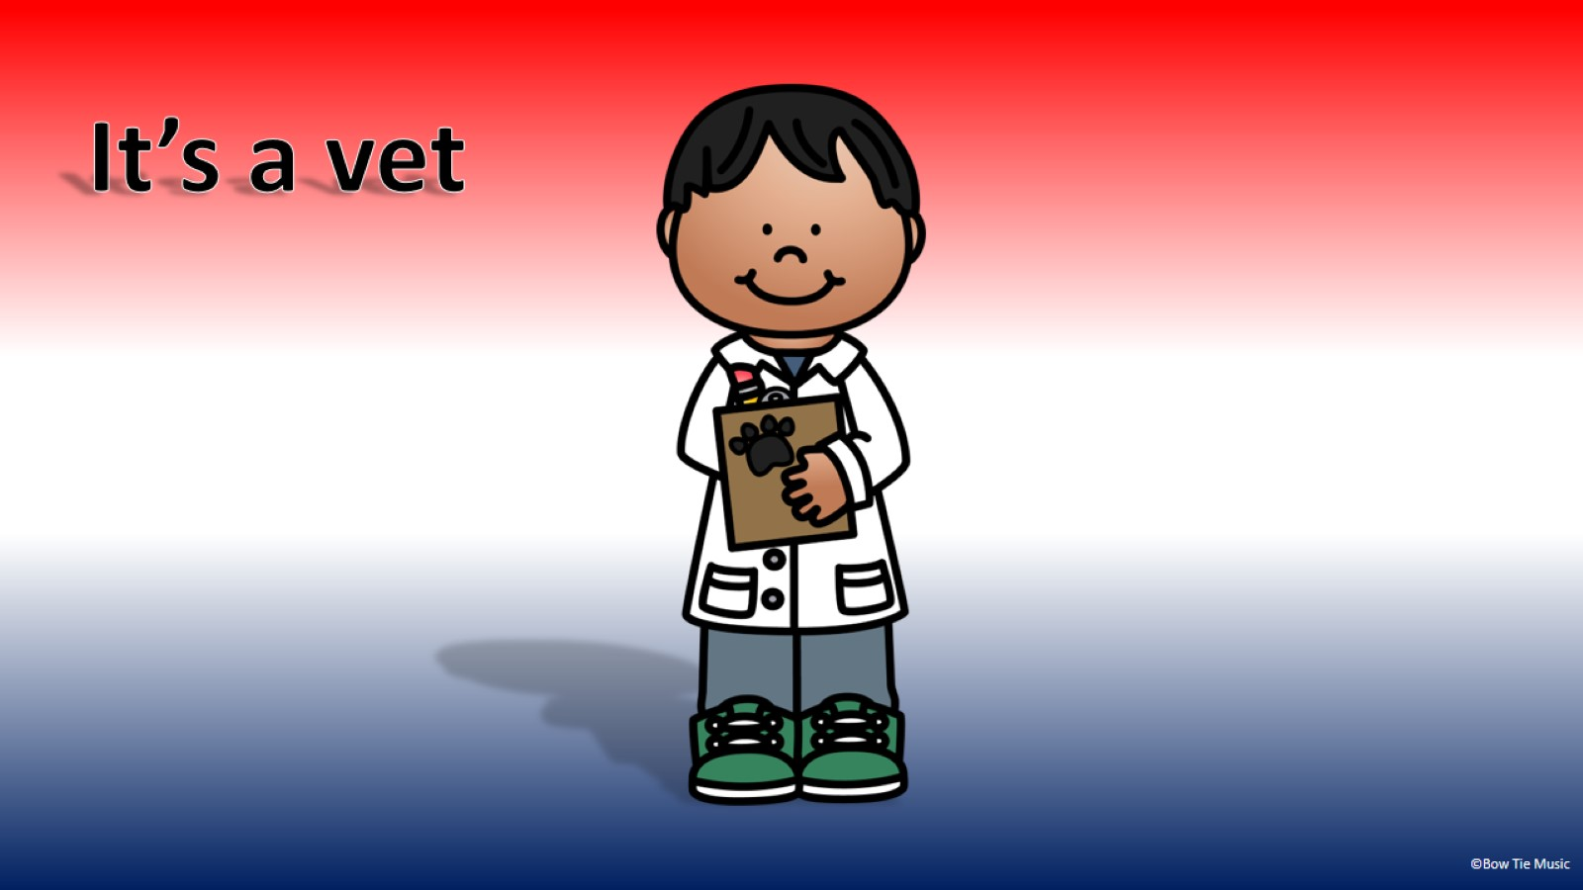

Slide 17
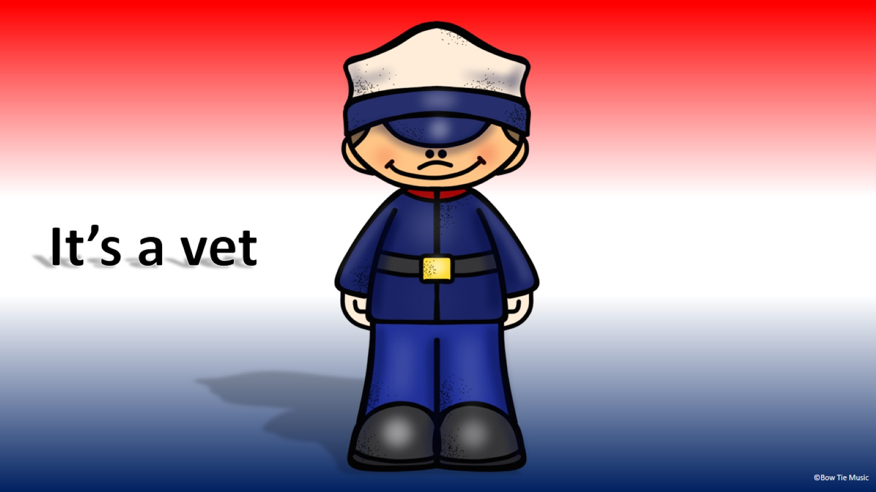

Slide 18
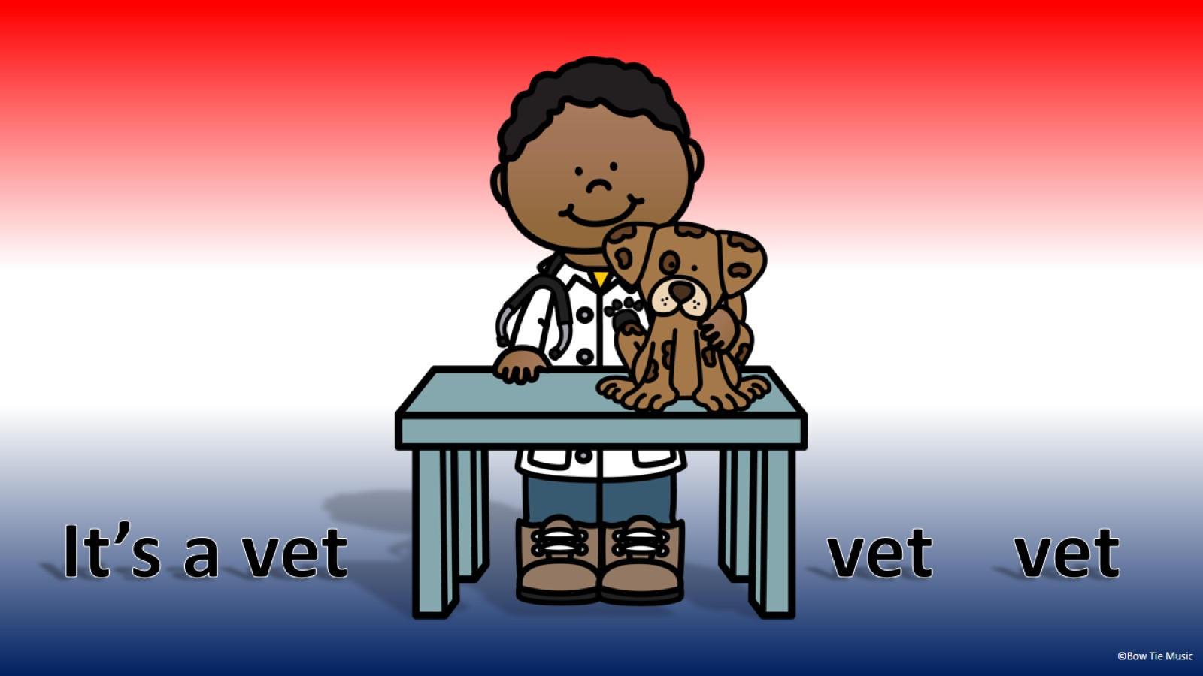

Slide 19
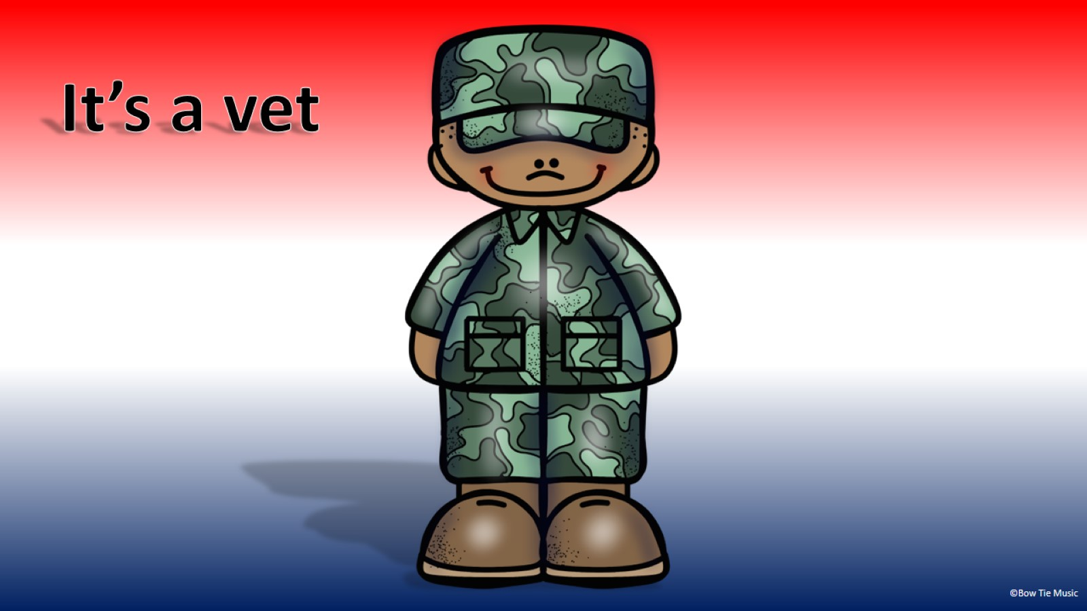

Slide 20
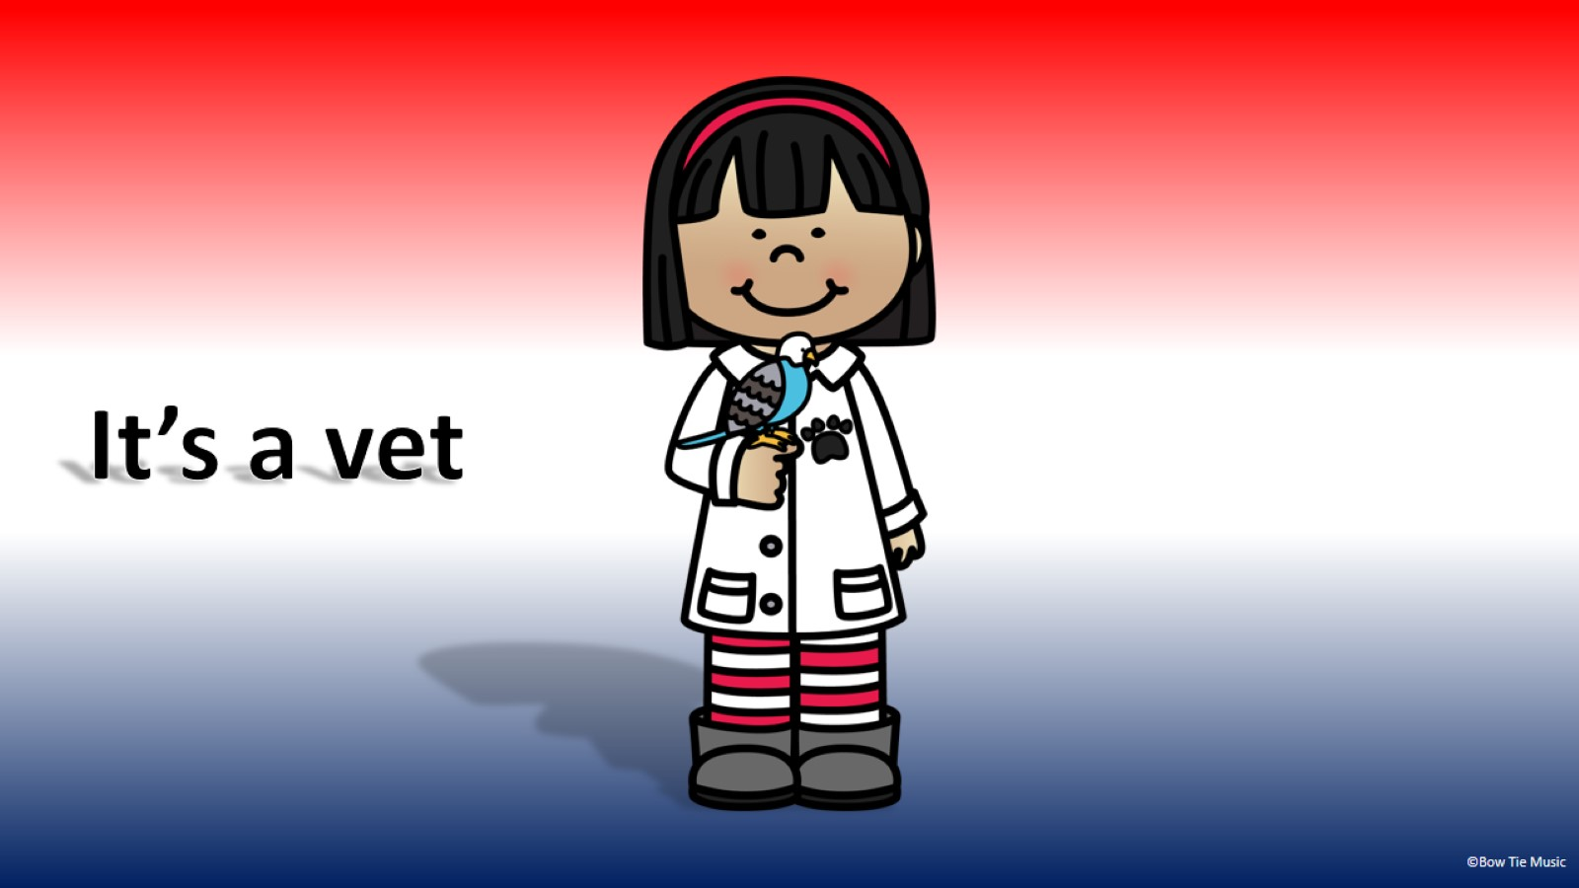

Slide 21
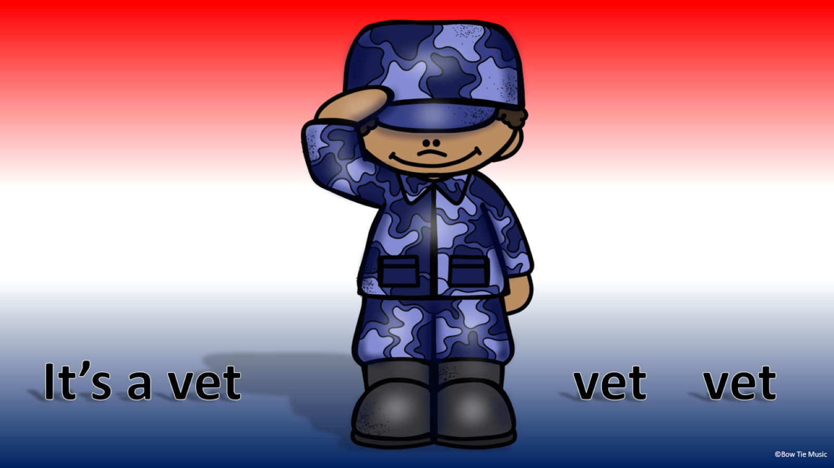

Slide 22
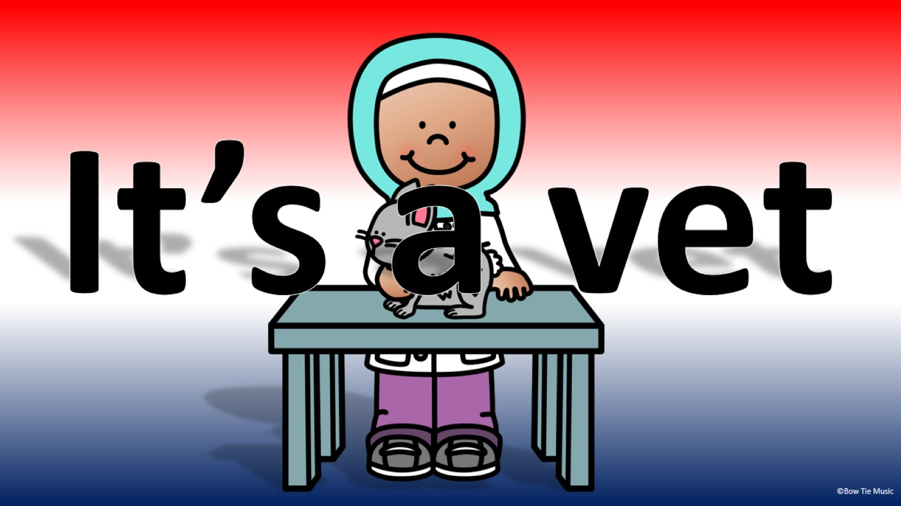

Slide 23
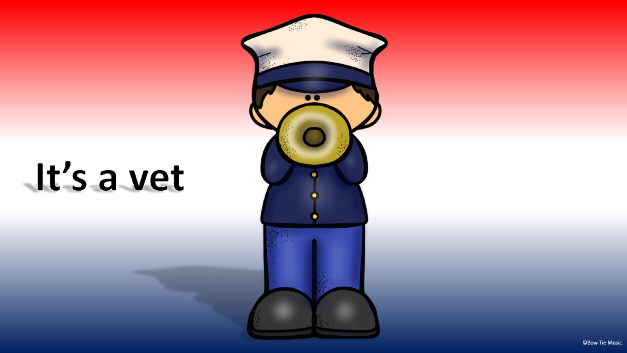

Slide 24


Slide 25


Slide 30


Slide 31




